Slide 1
The simplicity of business letters

Slide 2
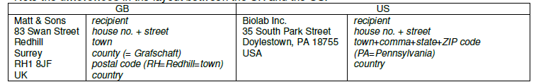
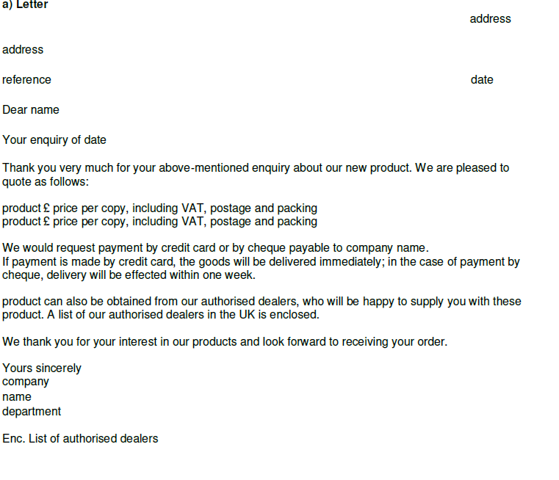
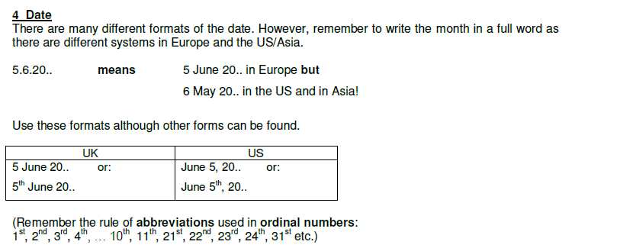

Slide 3
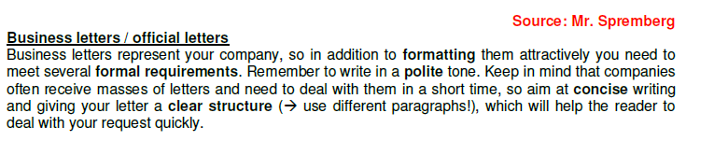
Think of a basic business letter in three steps:
Introduction - The reason for writing: The introduction helps the reader understand in which context the letter should be considered. Possibilities include job interview inquires, business opportunity requests, complaints, and more. Of course, Each type of business letter has its own standard phrases.
Details - What you would like to accomplish: The detail section of a business letter is extremely important. This is where you achieve your goals in writing a business letter.
Conclusion / Next Steps - What you would like to happen in the future: Provide a call for future action. This can be a chance to talk in person, a follow-up letter or more. It's important and expected to make it clear what you would like for the next step from the person reading your business letter.

Slide 4
Salutation
Dear Personnel Director,
Dear Sir or Madam: (use if you don't know who you are writing to)
Dear Dr, Mr, Mrs, Miss or Ms Smith:
(use if you know who you are writing to, and have a formal relationship with )
Dear Frank: (use if the person is a close business contact or friend)
Title of respect | Pronunciation | Meaning
Ms | /mɪz/ | independent of marital status
Mrs | /ˈmɪs ɪz, ˈmɪz ɪz/ | t. of r. for a married woman
Miss | /mɪs/ | t. of r. of an unmarried woman
The Reference
Begin by referencing a specific conversation or other contact means. If this is the first letter in a conversation, you can also provide the reason for writing.
With reference to
-your advertisement in the Times,
-your letter of 23 ^{rd} March, -your phone call today,
Thank you for your letter of March 5 ^{th} .

Slide 5
The Reason for Writing
I am writing to...
... inquire about ... apologize for ... confirm ... comment on ... apply for
Examples:
I am writing to inquire about the position posted in The Daily Mail. I am writing to confirm the shipment details on order # 2346. I am writing to apologize for the difficulties you experienced
last week at our branch.
Once you have introduced the reason for writing your business letter, move on to stating more specifically the purpose of your letter.
Here are a number of possibilities:
Requesting
Could you possibly? I would be grateful if you could
Agreeing to Requests
I would be delighted to
Giving Bad News
Unfortunately I am afraid that
Examples:
Would you please forward your job requirements?
I am afraid that I will be unable to attend the conference
next week.
I would be delighted to give you a tour of our facility
this coming month.

Slide 6
Enclosing Documents
I am enclosing Please find enclosed Enclosed you will find
Closing Remarks
Thank you for your help.
Please contact us again
if we can help in any way. if there are any problems. if you have any questions.
Reference to Future Contact
I look forward to ... hearing from you soon. meeting you next Tuesday. seeing you next Thursday.
The Finish
Yours faithfully, (If you don't know the name of the person you're writing to)
Yours sincerely, (If you know the name of the person you're writing to)
Best wishes,
Best regards, (If the person is a close business contact or friend)

Slide 7
Sample Letter
Ken's Cheese House 34 Chatley Avenue Seattle, WA 98765 Tel: Fax:
October 23, 2006
Fred Flintstone Sales Manager Cheese Specialists Inc. 456 Rubble Road Rockville, IL
Dear Mr Flintstone:
With reference to our telephone conversation today, I am writing to confirm your order for:
120 x Cheddar Deluxe Ref. No. 856. The order will be shipped within three days via UPS
and should arrive at your store in about 10 days.
Please contact us again if we can help in any way.
Yours sincerely,
Kenneth Beare Director of Ken's Cheese House

Slide 8
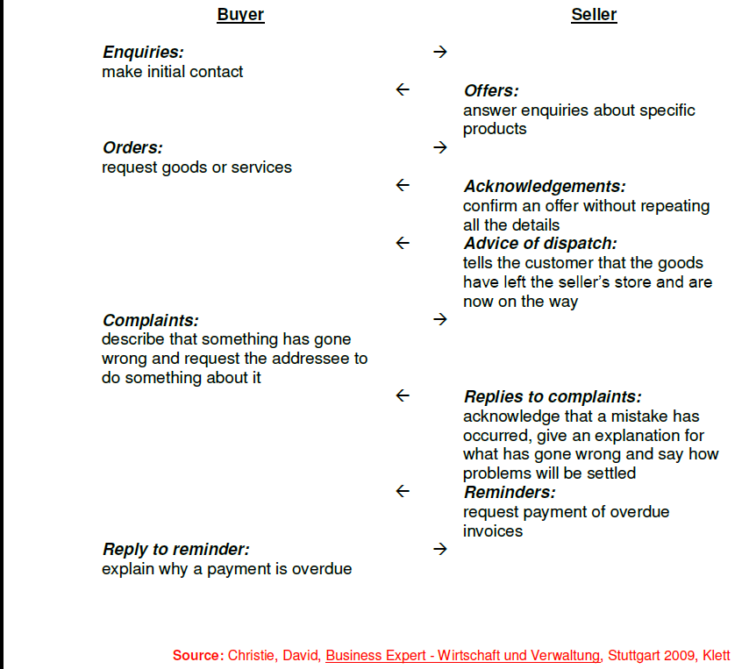

Slide 9
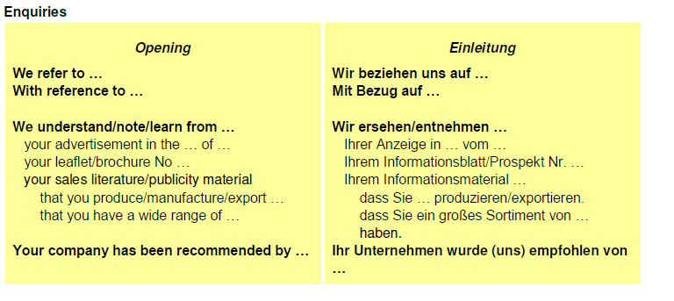

Slide 10
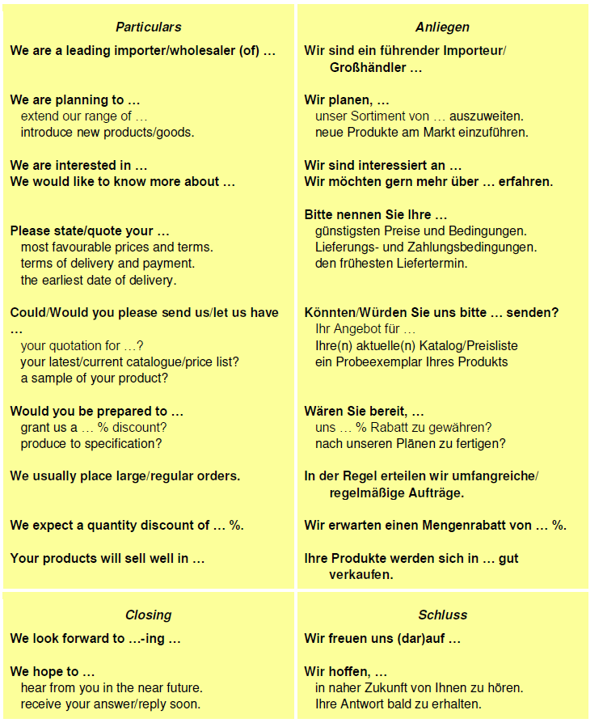

Slide 11
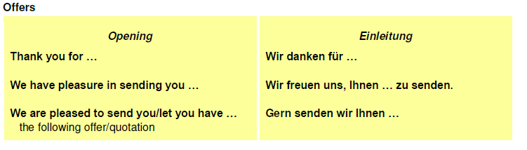
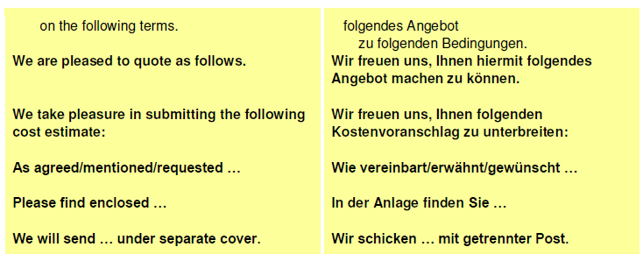

Slide 12
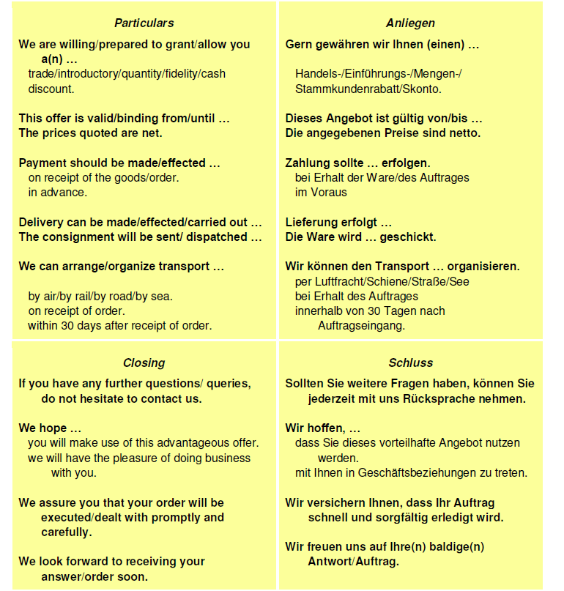

Slide 13
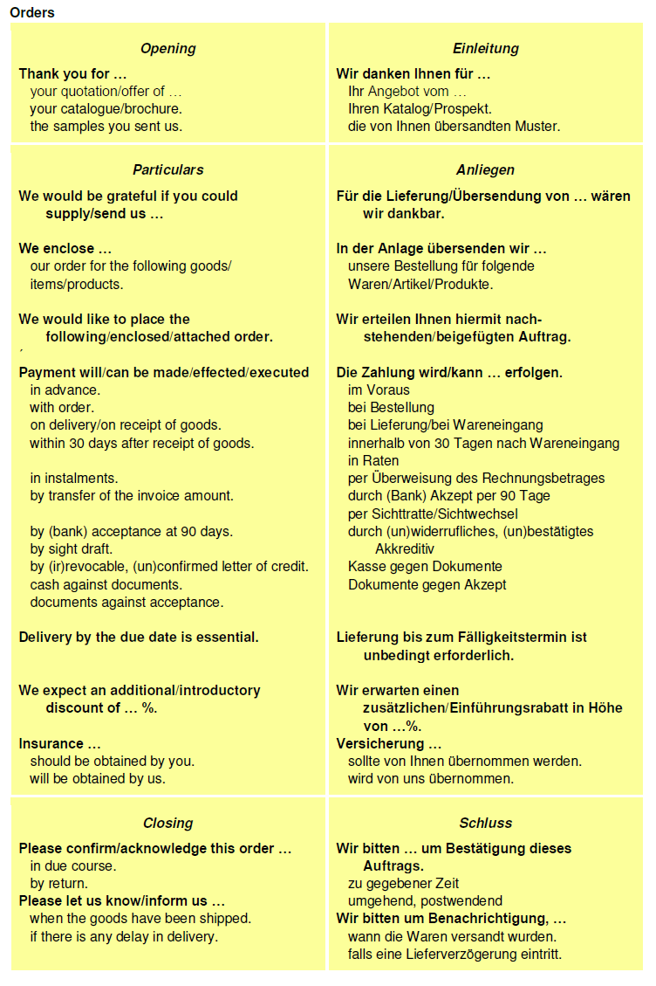

Slide 15
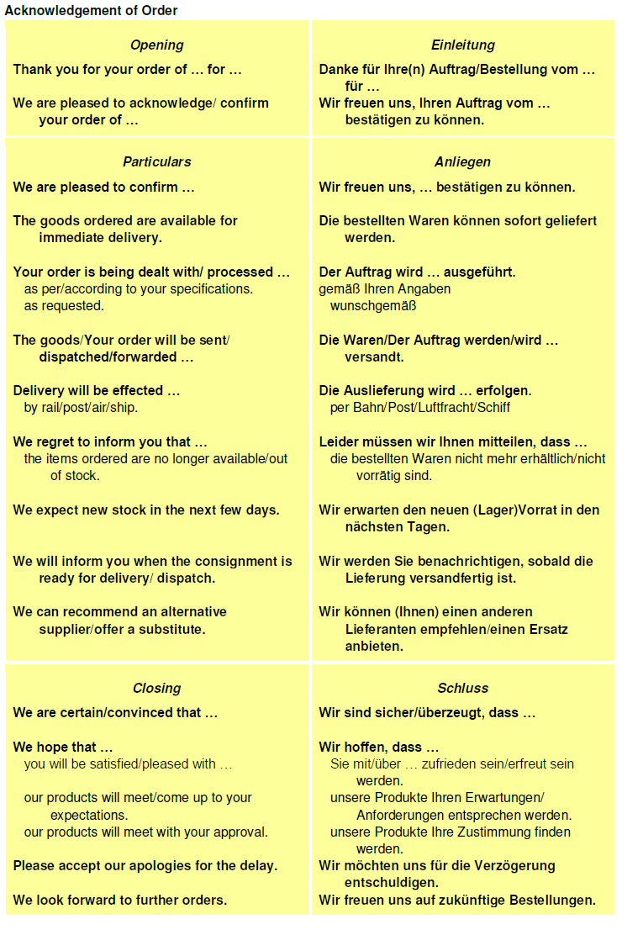

Slide 17
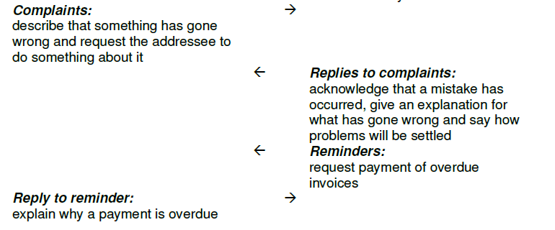
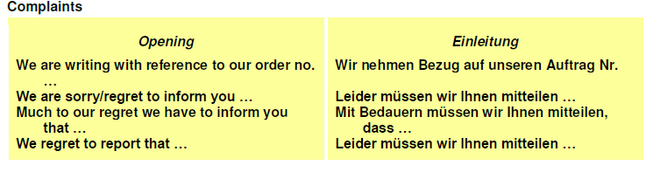

Slide 18
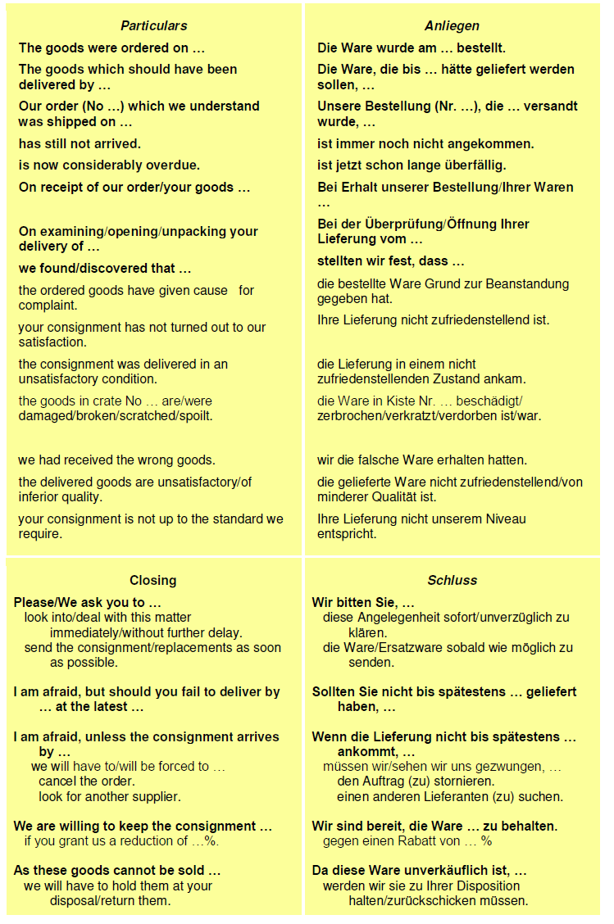

Slide 19
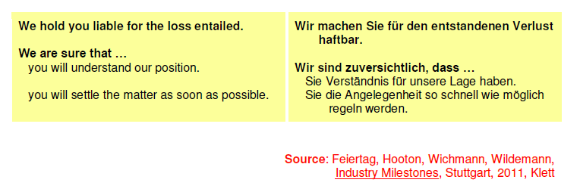

Slide 20
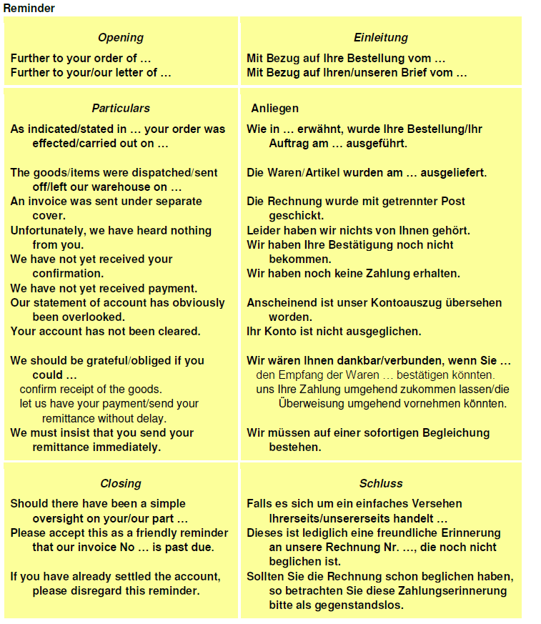

Slide 21
